Slide 1
TRAVEL MATE
Devika P
MCA A Batch

Slide 2
RELEVANCE OF TOPIC
Travel mate is a mobile application which helps the user to travel and explore new places. In this present world as number of shopping malls increase people are forgetting about the natural beauties they should visit at least once in their whole life time.most of these natural beauties are located to rural areas,information or details about these places could not be easily acquired by the external user.travel mate provides information about these places so the user could easily get details and direction of the place.Travel mate mainy focused on travellers and foreigners to make their trip more comfortable.

Slide 3
DESCRIPTION
Travel mate is mainly focused on travelers/foreigners make the app as an all in one based on the customer needs.This application provides a complete details of the hotel/resort booking, ,bus booking etc.by using travel mate user can book bus,rooms, by providing the particular dates.
The application also provide the user a feature through which they could mark the place in their favourite list,so next time it would be esay for the user to find the destination as it would be listed in the home page ,the user also get the details of the place attractions,weather,atm,hospitals etc

Slide 4
OBJECTIVE
The main objective of the project is to assist the user in travelling and exploring the wonder around them.This app provides a complete details of bus, hotel/resorts and includes booking services such as hotel/resort,bus booking etc.user can mark the best place in the favourite list .

Slide 5
EXISTING SYSTEM
Travel assisting applications, some of them show details of restaurants and hotels where some show information and attractions. It would be difficult for a user to go through different types of applications to know the complete details about the destination which would also time consuming.
The budget is an important factor for a journey. The drawback of the system is that it cannot record the persons expenses during their travelling.
.

Slide 6
PROPOSED SYSTEM
Travel mate is an android application by which an individual can access through all the information related to a destination, providing the details of hotels, tourist places , petrol pump and information about the place..
User can book the bus/hotel at anytime and also have an option to cancel the booking
The key feature of this app is that it provide the information about the unpopular places which could be hard for the user to find the direction and other details about the place. The application also provide the user a feature through which they could mark the place in their favorites list.So,next time it would be easy for the user to find the destination as it would be listed in the home page.
This application also calculate expenses and remind traveler. Expense tracker is an another application for travelers to know their amount spend

Slide 7
MODULES
Login
In this module the registered user can login to the android application with their respective username and password given at the time of registration.
Search
After successful login the user has the provision of searching the place they desire to travel.After searching the user will be provided with a list o hotels,attractions restuarents ,hospitals and the information about the place.
Bus booking
The user can book the bus by giving the details like no of passengers,date etc.User get the notifications and updates about the booking.

Slide 8
Hotel /Resort booking
The user can book the hotel/resort using the application.user can view the details such as rooms, entertainment facilietes etc
Tour Cancellation
Users may even cancel their tour if they wish
Expense note
User can give amount of their expense and the total expense is displayed.

Slide 9
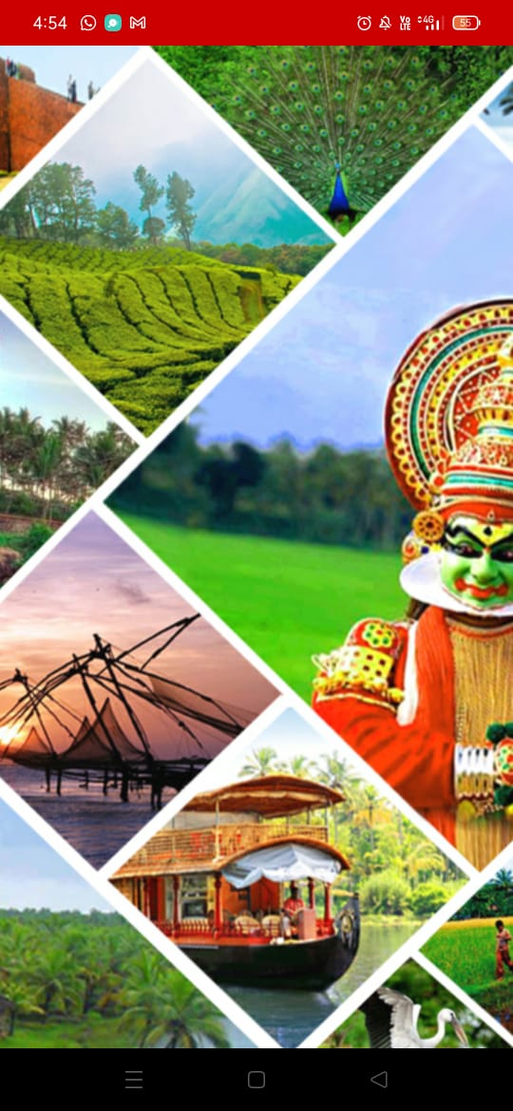
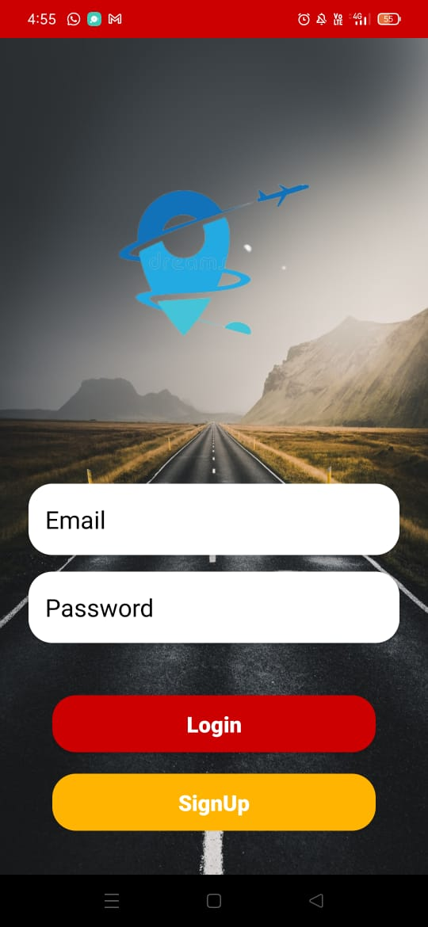
Screenshots
Splash page Login page

Slide 10
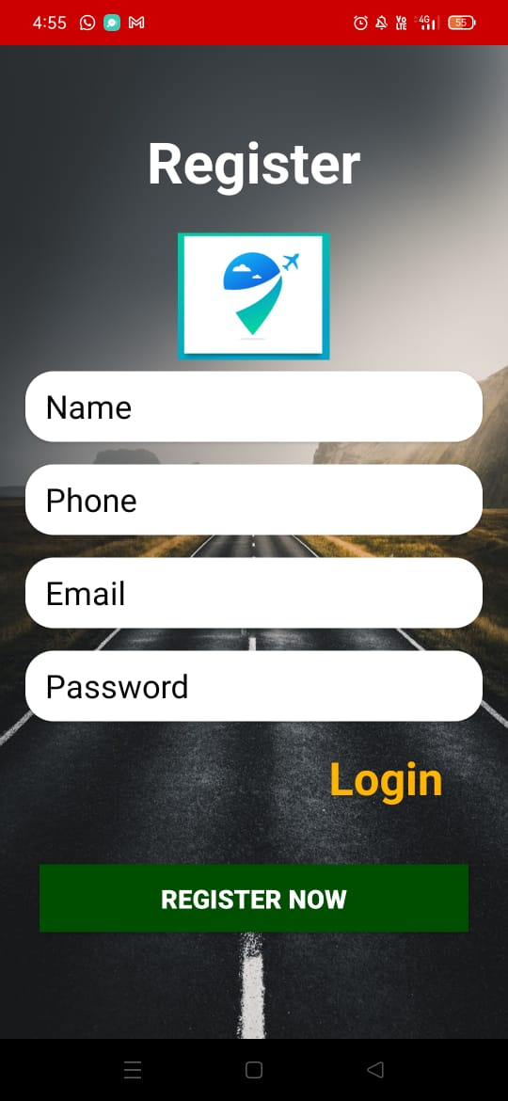
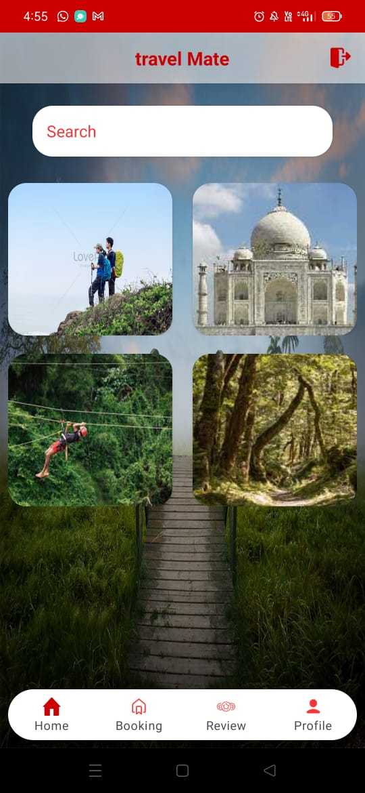
Registeration Home page

Slide 11
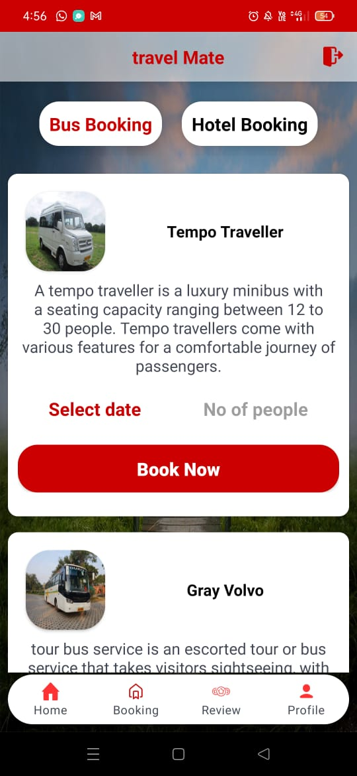
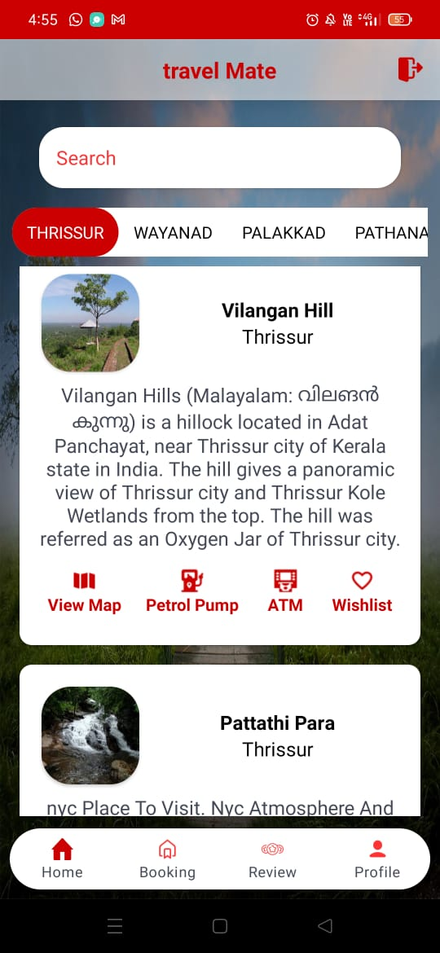
Trekking Booking

Slide 12
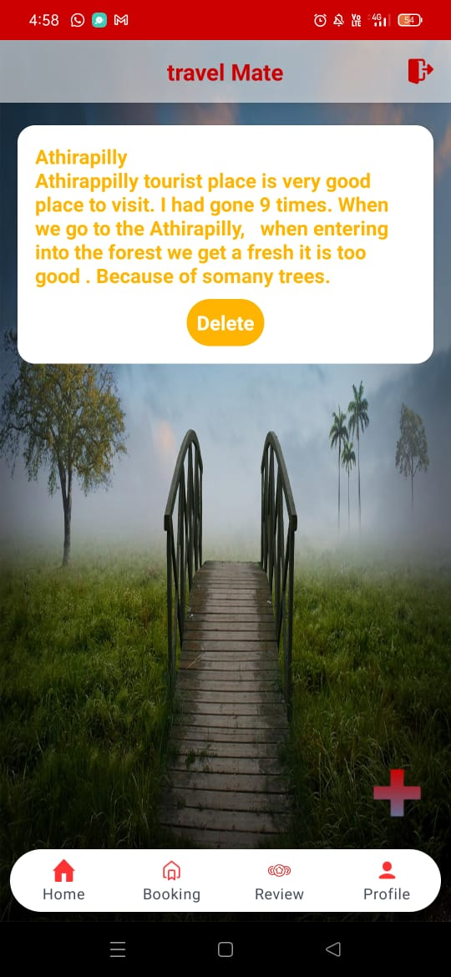
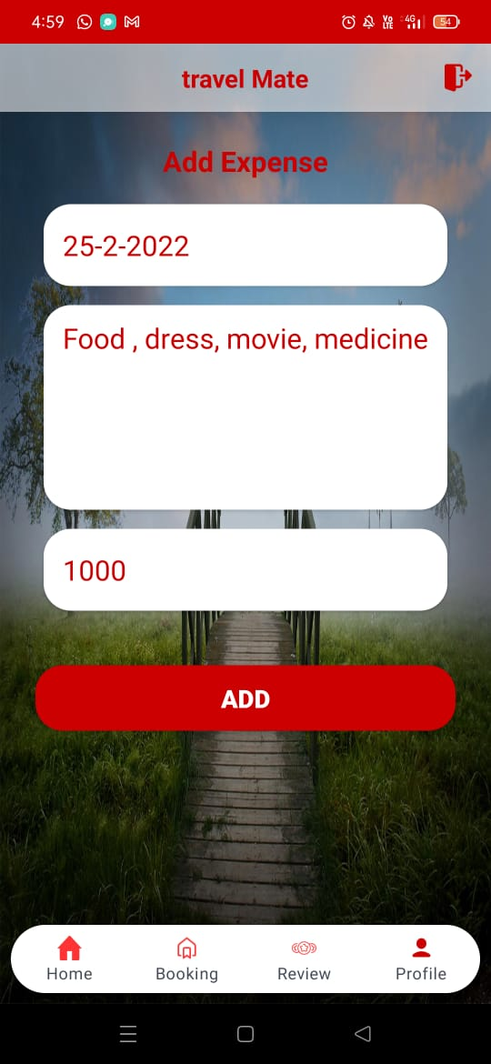
Review Expense note

Slide 13
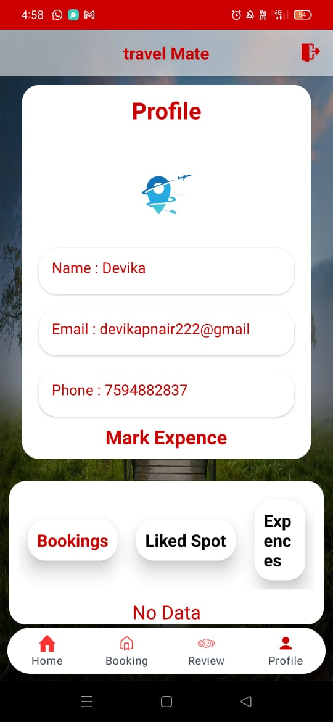
Profile

Slide 14
Future Enhancement
In future the application can include an option for adding the travel vlog,provide a platform for the travelers they can share their experience through photos or vlogs
in future give an feature that the blind can also use the app with the help of a voice assistant
To add a module guide booking for assist the user,it helps to unemployed people can work as a guide

Slide 15
THANK YOU

